Slide 1
Text Editors

Slide 2
Text Editors
Text editor acts as an interface to the computer for all type of computer-based information processing operations such as compose, organize, study, manipulate etc.
A text editor allows you to edit a text file (create, modify etc)
Text editors on Windows OS - Notepad, WordPad, Microsoft Word etc..
Text editors on UNIX OS - vi, emacs, jed, pico etc.
common editing features include Moving the cursor, Deleting, Replacing, Pasting, Searching, replacing, Saving, loading etc.

Slide 3
Editing process
An interactive editor is a computer program that allows a user to create and revise a target document.
Document includes objects such as computer programs, text, equations , tables, diagrams, line art, and photographs.
we restrict to text editors, where character strings are the primary elements of the target text.

Slide 4
Editing process
Document-editing process has four tasks
- Select the part of the target document to be viewed and manipulated.
- Determine how to format this view on-line and how to display it.
- Specify and execute operations that modify the target document.
- Update the view appropriately
These tasks involves traveling, filtering and formatting.

Slide 5
Editing process
- Traveling – locate the area of interest
- Filtering - extracting the relevant subset (selects what is to be viewed and manipulated)
- Formatting – determines how the result of the filtering will be seen as a visible representation (view) on a display screen.
Editing phase involves the set of operations such as insert, delete, replace, move, copy, cut, paste, etc…

Slide 6
Two types of editors - Manuscript-oriented editor and program oriented editors.
Manuscript-oriented editor operate on elements such as characters, words, lines, sentences and paragraphs.
Program-oriented editor might operate on identifiers, keywords, statements etc.

Slide 7
User Interface
The user of an interactive editor is presented with a conceptual model of the editing system.
Conceptual model provides an abstraction of the target document and its elements.
User interface is also concerned with the input devices, the output devices and the interaction language.
The input devices are used to enter elements of text being edited, to enter commands and to identify editable elements.
The output devices, lets the user view the elements being edited and the results of the editing operations and,
the interaction language provides communication with the editor.

Slide 8
Input Devices
Input Devices are divided into three categories:
text devices, button devices and locator devices.
- Text Devices are keyboards.
- Button Devices generate an interrupt causing invocation of an associated application -program action.
- Such devices include a set of special function keys or display text strings or symbols on the screen. User chooses a symbol or string instead of pressing a button.
- Locator Devices : analog –to – digital converters that position a cursor on the screen. eg:- mouse, data tablet.
There are voice input devices which translates spoken words to their textual equivalents.

Slide 9
Output Devices
Let the user view the elements being edited and the results of the editing operations.
Teletypewriters (first output devices),
Glass teletypes(based on Cathode ray tube (CRT) technology),
Advanced CRT terminals, TFT Monitors
(Wysiwyg) and
Printers (Hard-copy).

Slide 10
Interaction Language
Typing or text command oriented and menu-oriented.
Typing oriented or text command oriented interaction was with oldest editors, in the form of use of commands, use of function keys, control keys etc.,
Menu-oriented user interface has a menu with a multiple choice set of text strings or icons.
Display area for text is limited.
Menus can be turned on or off.

Slide 11
Interaction Language
Typing oriented system require familiarity with system and language.
Function key oriented systems have either too few keys (require multiple keystroke commands) or too many unique keys (results in a keyboard).
Menu oriented systems attempt to address these problems.
Display area for text is limited.
User might be presented with several consecutive menus in a hierarchy before the appropriate command and its options appear.

Slide 12
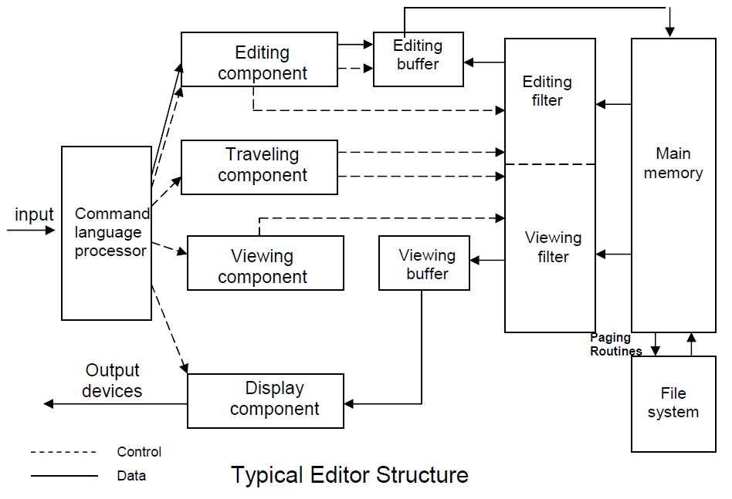
Editor Structure

Slide 13
Editor Structure
Command language Processor accepts input from input devices and analyze the tokens and syntactic structure of the commands.
It functions much like the lexical and syntatic phases of a compiler.
The command language processor may invioke semantic routines directly.
The semantic routines involve traveling, editing, viewing and display functions.

Slide 14
Editor Structure
Editing operations are specified explicitly by the user and display operations are specified implicitly by the other three categories of operations.
Traveling and viewing operations may be invoked either explicitly by the user or implicitly by the editing operations.
In editing a document, the start of the area to be edited is determined by the current editing pointer maintained by the editing component.
Editing component is a collection of modules dealing with editing tasks.
Current editing pointer can be set or reset with the traveling commands such as next paragraph, next screen, cut paragraph, paste paragraph etc..,.

Slide 15
Editing a document
The traveling component of the editor set the current editing and viewing pointers and thus determine the point at which the viewing and/or editing filtering begins.
When editing command is issued, editing component invokes the editing filter.
The editing components filters the document to generate a new editing buffer based on the current editing pointer and the editing filter parameters.
editing buffer contains part of the document to be edited from current editing pointer.
Filtering and editing may be interleaved, with no explicit editor buffer being created.

Slide 16
Editing a document
In viewing a document, the start of the area to be viewed is determined by the current viewing pointer maintained by the viewing component.
Viewing component is a collection of modules responsible for determining the next view.
Current viewing pointer can be set or reset explicitly by the user with a traveling command or implicitly by the system as a result of previous editing operation.

Slide 17
Editing a document
When display needs to be updated, viewing component invokes the viewing filter.
It filters the documents to generates a new viewing buffer based on the current viewing pointer and the viewing filter parameters.
These parameters determine part of the document to be viewed from current viewing pointer.
In case of line editors viewing buffer may contain the current
line.
Screen editors - viewing buffer contains a rectangular cutout of the quarter plane of the text.

Slide 18
Editor Structure

Slide 19
Editing a document
Viewing buffer is then passed to the display component of the editor, which produces a display by mapping the buffer to a rectangular subset of the screen – called a window.
The editing and viewing buffers may be identical or may be completely disjoint.
Identical – user edits the text directly on the screen.
Disjoint – Find and Replace . For example, there are 150 lines of text, user is in 100th line, decides to change all occurrences of ‘text editor’ with ‘editor’ in lines 1 through 50 of the file.
Lines 1 through 50 are filtered from the document to form the editing buffer.
Successive substitutions take place in the editing buffer without corresponding updates of the view.

Slide 20
Editing a document
The editing and viewing buffers can also be partially overlap, or one may be completely contained in the other.
Viewing buffer contains part of the document that is visible on the screen, only the last part of which is in the editing buffer.
Windows typically cover entire screen or a rectangular portion of it.
May show different portions of the same file or portions of different file.
Inter-file editing operations are possible.

Slide 21
The components of the editor deal with a user document on two levels: In main memory and in the disk file system.
Loading an entire document into main memory may be infeasible – only part is loaded .
This problem is solved by mapping the entire file into virtual memory and let the OS perform demand paging .
An alternative is to use editor paging routines, which read one or more logical portions of a document into memory as needed – such portions are termed as pages.

Slide 22
Types of editors based on computing environment
Editors function in three basic types of computing environments: Time sharing, Stand-alone, and Distributed.
In time sharing environment, editor must function within the context of the load on the computer’s processor, memory and I/O devices.
In stand-alone environment, editors on stand-alone system are built with all the functions to carry out editing and viewing operations – The help of the OS may also be taken to carry out some tasks like demand paging.
In distributed environment, editor has both functions of stand alone editor, to run independently on each user’s machine and like a time sharing editor, contend for shared resources such as files.

Slide 23
Debugging Systems
An interactive debugging system provides programmers facilities that aid in testing and debugging of programs.
Here we discuss
- Important functions and capabilities of IDS
- Relationship of IDS to other parts of the system
- The nature of the user interface for IDS

Slide 24
Debugging Functions and Capabilities
Observation and control of the flow of program execution.
  Programmer can set break points – which cause execution to be suspended when a specified point in the program is reached.
  - After execution is suspended, use debugging commands to analyze the progress of the program and to diagnose errors.
  - then the execution of the program can be resumed.

Slide 25
Debugging Functions and Capabilities
As an alternative, programmer can define conditional expressions that are evaluated during the debugging session.
Program execution is suspended when any of these conditions become true.
Then the debugging commands are executed.

Slide 26
Debugging Functions and Capabilities
Tracing and traceback.
Tracing - used to track the flow of execution logic and data modifications.
The control flow can be traced at different levels of detail : procedure, branch, individual instruction, and so on…
Tracing can also be based on conditional expressions.

Slide 27
Debugging Functions and Capabilities
Traceback - show the path by which the current statement in the program was reached.
It can also show which statements have modified a given variable or parameter.
The kind of statements should be displayed symbolically, rather than as hexadecimal displacements

Slide 28
Debugging Functions and Capabilities
A debugger should have good program-display capabilities.
Program being debugged should be displayed complete with statement numbers
Keeping track of any changes made to the programs during the debugging session.
The system should save all debugging specifications (break point definitions, display modes etc.)
Programmer need not reissue these debugging commands across recompilation.

Slide 29
Debugging Functions and Capabilities
To provide these functions, a debugger should consider the language in which the program being debugged is written.
Most user environments support several programming languages.
We require a single debugging tool applicable to multiple languages.
Debugger commands should be language independent.
However, the debugging system must be sensitive to the specific language being debugged.

Slide 30
The context being used has many different effects on the debugging interaction.
The statements are different depending on the language.
Assignment statements : Cobol - MOVE 6.5 TO X
Fortran - X = 6.5
C - X = 6.5
Similarly, the condition that X be unequal to Z may be expressed as
Cobol - IF X NOT EQUAL TO Z
Fortran - IF ( X.NE.Z)
C - IF ( X <> Z)
Similar differences exist with respect to the form of statement labels, keywords and so on…

Slide 31
The notation used to specify certain debugging functions varies according to the language of the program being debugged.
However, the functions are accomplished in the same manner regardless of the source programming language.
To perform these actions, the debugger must have access to the information gathered by the language translator.
Sometimes the language translator itself has debugger interface modules that can respond to the request for debugging by the user.
The source code may be displayed by the debugger in the standard form or as specified by the user or translator.

Slide 32
It is also important that a debugging system be able to deal with optimized code. Many optimizations like
- Invariant expressions can be removed from loops
- Separate loops can be combined into a single loop
- Redundant expression may be eliminated
- Elimination of unnecessary branch instructions
Leads to rearrangement of segments of code in the program. All these
optimizations create problems for the debugger, and should be handled carefully.

Slide 33
Relationship with Other Parts of the System
The important requirement for an interactive debugger is that it always be available.
Must appear as part of the run-time environment and an integral part of the system.
When an error is discovered, immediate debugging must be possible., because it may be difficult or impossible to reproduce the program failure in some other environmemt or at some other time.
The debugger must communicate and cooperate with other operating system components such as interactive subsystems.

Slide 34
Debugging is more important at production time than it is at application development time.
When an application fails during a production run, work dependent on that application stops.
The debugger must be consistent with the security and integrity components of the system.
No one should be able to use debugger to access unauthorised data.
The debugger must coordinate its activities with those of existing and future language compilers and interpreters.

Slide 35
User-Interface Criteria
Debugging systems should be simple in its organization and familiar in its language.
The facilities of a debugging system should closely reflect common user tasks. The simple organization contribute greatly to ease of training and ease of use.
The user interaction should make use of full-screen displays and windowing-systems as much as possible. With menus and full-screen editors, the user has far less information to enter and remember.

Slide 36
There should be complete functional equivalence between commands and menus
– user where unable to use fullscreen IDSs may use commands. The command language should have a clear, logical and simple syntax;
command formats should be as flexible as possible.
Any good IDSs should have an on-line HELP facility. HELP should be accessible from any state of the debugging session.

Slide 37
Debugging by Brute Force
most common and least effective method of program debugging .
It requires little thought and is the least mentally taxing of all the methods.
The brute-force methods are characterized by either
- debugging with a memory dump;
- scattering print statements throughout the program, or - debugging with automated debugging tools.

Slide 38
Debugging with a memory dump - Drawbacks
  Establishing the correspondence between storage locations and the variables in the program is difficult.
  Massive amounts of data, most of which is irrelevant, must be dealt with.
  A dump shows only the static state of the program at only one instant in time. The dynamics of the program (i.e., state changes over time) are needed to find most errors.
  The dump is rarely produced at the exact-time of the error. Hence the dump does not show the program's state at the time of the error.
  No formal procedure exists for finding the cause of an error analyzing a storage dump.

Slide 39
Scattering print statements
It displays the dynamics of a program and allows one to examine information that is easier to read.
Drawbacks:-
  It is a hit-or-miss method.
  It often results in massive amounts of data to be analyzed.
  It requires changing the program, which can mask the error, alter critical timing or introduce new errors.
  It is often too costly or even infeasible for real-time software.

Slide 40
Debugging with automated debugging tools.
  It is a hit-or-miss method.
  It often results in massive amounts of data to be analyzed.
  The problem of changing the program is overcome by the use of the automated debugging tool.
  The biggest problem with the brute-force methods is that they ignore the most powerful debugging tool in existence, a well trained and disciplined human brain.
  In terms of the speed and accuracy of finding the error, people who use their brains rather than a set of "aids" seem to exhibit superior performance.

Slide 41
Debugging by Induction
Many errors can be found by using a thought process. One such thought process is induction.
By starting with the symptoms of the error, possibly in the result of one or more test cases, and looking for relationships among the symptoms, the error is often uncovered.

Slide 42
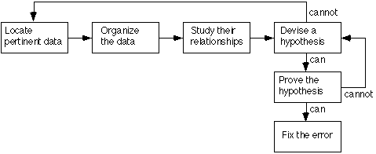
Inductive Debugging Process

Slide 43
Locate the pertinent data
  The first step is the enumeration of all that is known about what the program did correctly, and what it did incorrectly.
  Take into account of all available data or symptoms about the problems.
  Additional clues are provided by similar, but different, test cases that do not cause the symptoms to appear.
Organize the data.
  second step is the structuring of the pertinent data to allow one to observe patterns, of particular importance is the search for contradictions

Slide 44

The "What" boxes list the general symptoms.
The "Where" boxes describe where the symptoms were observed.
The "When" boxes list anything that is known about the times that the symptoms occur, and
The "To What Extent" boxes describes the scope and magnitude of the symptoms.
The "Is" and "Is Not" columns describe the contradictions that may eventually lead to a hypothesis about the error.

Slide 45
Devise a hypothesis
  Study the relationships among the clues and devise one or more hypotheses about the cause of the error.
  If one cannot devise a theory, more data are necessary, possibly obtained by devising and executing additional test cases.
  If multiple theories are possible, the most probable one is selected first.

Slide 46
Prove the hypothesis
  A failure to do this often results in the fixing of only a symptom of the problem, or only a portion of the problem.
  The hypothesis is proved by comparing it to the original clues or data, making sure that this hypothesis completely explains the existence of the clues.
  If it does not, either the hypothesis is invalid, the hypothesis is incomplete, or multiple errors are present.

Slide 47
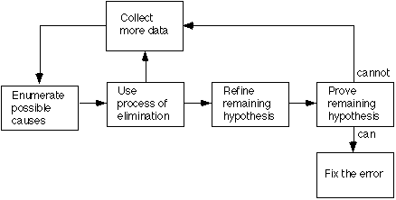
Debugging By Deduction
An alternate thought process
Deduction is a process of proceeding from some general theories or premises, using the processes of elimination and refinement, to arrive at a conclusion.
Deductive Debugging Process

Slide 48
Enumerate the possible causes or hypotheses.
  develop a list of all conceivable causes of the error.
  They need not be complete explanations; they are merely theories through which one can structure and analyze the available data.
Use the data to eliminate possible causes.
  By a careful analysis of the data (looking for contradictions ) one attempts to eliminate all but one of the possible causes.
  If all are eliminated, additional data are needed to devise new theories. If more than one possible cause remains, the most probable cause (the prime hypothesis) is selected first

Slide 49
Refine the remaining hypothesis.
  The possible cause at this point might be correct, but it is unlikely to be specific enough to pinpoint the error.
  Hence, the next step is to use the available clues to refine the theory to something more specific.
Prove the remaining hypothesis.
  identical to the fourth step in the induction method (Prove the hypothesis)

Slide 50
Debugging by Backtracking
Used in small programs.
Start at the place in the program where an incorrect result was produced and go backwards in the program one step at a time, mentally executing the program in reverse order, to derive the state (or values of all variables) of the program at the previous step.
Continuing in this fashion, the error is localized between the point where the state of the program was what was expected and the first point where the state was not what was expected.

Slide 51
Debugging by Testing
uses additional test cases.
Often used in conjunction with the induction method to obtain information needed to generate a hypothesis and/or to prove a hypothesis and with the deduction method to eliminate suspected causes, refine the remaining hypothesis, and/or prove a hypothesis.

Slide 52
Device Drivers
A device driver is a computer program that controls a particular device that is connected to the computer.
A driver provides a software interface to hardware devices, enabling operating systems and other computer programs to access hardware functions without knowing details of the hardware being used.

Slide 53
Device drivers act as a translator between the operating system of the computer and the device connected to it.
For many types of devices, the necessary drivers are built into the operating system.
When you plug in a device, the operating system starts looking for the right driver, installs it and you are ready to start using the device.
This is referred to as plug-and-play and is much preferred over having to manually install the correct drivers.

Slide 54
Many hardware devices, come with the necessary drivers.
For example, if you buy a printer, it may come with a CD that typically will include the correct driver.
The advantage of this is that the hardware manufacturer can make sure you have the right driver for the printer.
A device driver converts general I/O instructions into device specific operations.

Slide 55
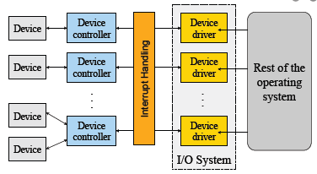
Anatomy of a Device Driver
A device driver has three sides: one side talks to the rest of the kernel, one talks to the hardware, and one talks to the user.

Slide 56
Block and Character Devices
A Block ('b') Device is one with which the Driver communicates by sending entire blocks of data.
Eg:- hard disks, USB cameras, Disk-On-Key.
A Character ('c') Device is one with which the Driver communicates by sending and receiving single characters (bytes, octets).
Eg:- ports, parallel ports, sounds cards.

Slide 57
Block devices
Organize data in fixed-size blocks
Transfers are in units of blocks
Blocks have addresses and data are therefore addressable
E.g. hard disks, USB disks, CD-ROMs
Character devices
Delivers or accepts a stream of characters, no block structure
Not addressable, no seeks
Can read from stream or write to stream
Printers, network interfaces, terminals

Slide 58
Device driver works within the kernel layer of the OS.
Kernel is the part of the OS that directly interacts with the physical structure of the system.
Instead of accessing the device directly, the OS loads the device drivers and calls the specific functions in the driver software to execute specific tasks on the device.

Slide 59
Eg: printer
When we choose an operation (ctrl+P), this command goes to the device driver through the kernel of the OS.
A calling program invokes a routine in the device driver.
The driver issues corresponding commands to the microcontrollers within the printer.
These microcontrollers control the components of the printer.

